Slide 1
Principles and Culture of Data Science May 25, 2019
Lecture 2, Applied Data Science
MMCi Term 4, 2019
Matthew Engelhard
Notes:
Name
Department & DS Program
I work in…
I’m here to…
This will be the first of three lectures this spring focused on ways data science is positioned to change (and beginning to change) clinical practice. We’re doing this because we think these technologies are going to have a major impact on the way you practice medicine, and we want you to be ready for them.

Slide 2
What are Machine Learning and Data Science?
Increasing Hype
“cognitive computing”
“artificial intelligence”
“predictive analytics”
“curve fitting”
“better stepwise regression”
“statistics for programmers”
Notes:
A3: Judea Pearl
A4: not hype – probably too limited!

Slide 3
Q: What is Machine Learning?
“ML is an algorithmic field that blends ideas from statistics, computer science and many other disciplines to design algorithms that process data, make predictions and help make decisions” – M. I. Jordan
Notes:
MI Jordan, arguably one of the greatest of all time in ML --
Algorithmic – theory of algorithms rather than theory of statistics
Interdisciplinary
Predictive (and make decisions) – focused on action rather than interpretation
Process data – this is not statistical theory
Other fields:
Optimization and operations research
Engineering, e.g. control theory
Neuroscience (day 2)
Cognitive science
linguistics

Slide 4
“Statistical Learning”
Can’t squeeze information that doesn’t exist out of a dataset
So, scientific and clinical judgement remain critical to success
Machine
Learning
Statistics
Notes:
Both ML and statistics:
are based in math and probability
fit mathematical models to data
Compared to statisticians, ML practitioners tend to:
be willing to use models with fewer statistical guarantees
emphasize prediction over explanation
focus more on model architectures and less on feature crafting and selection
Neither field can squeeze information that doesn’t exist out of a dataset!
Extremely closely related fields; in fact the overlap probably isn’t large enough
Success of machine learning tied to the success of big data.
Statistics is changing too.
Note: prediction is not longitudinal – used in a statistical sense

Slide 5
“Big DAta”: Distinction or Meme?
Notes:
Play both sides here

Slide 6

Notes:
No doubt the role of data in our lives has changed. We’re in the information age!
Privacy, algorithm-curated news, recommendation systems – all of these have come from big data, internet, etc, and they don’t feel like statistics.
But is big data really the distinguishing factor? Maybe… but maybe it’s that these systems are focused on PREDICTION and ACTION rather than describing data and understanding relationships.

Slide 7
Notes:
Again, there’s no doubt we’re in the big data age, and health care is right there in it.
Flooded with information
It goes beyond what’s here – ultimately it’s a consequence of the internet and information age, in which data are primary

Slide 8
Big Data
Long Data
Large N
A clinical study with 50k participants
A speech database with 10M short recordings
Wide Data
Large M
A mHealth study with 6 months of wearables data in 20 participants
10 minutes of raw fMRI data in 8 participants

Slide 9
“Big Data”: Distinction or Meme?
“We can immediately reject ‘big data’ as a criterion for meaningful distinction between statistics and data science”
-- David Donoho, 50 years of Data Science
His points:
Statisticians have been looking at big data, e.g. census data, for >200 years.
Statisticians have long studied sampling and sufficient statistics, which allow them to work with big datasets

Slide 10
Neural networks thrive on big data
Inception v3 Convolutional Neural Network
Notes:
I’m not so sure – neural networks have brought about a totally different approach to dealing with wide data – lots of measurements per person – where we simply learn to process these data from the ground up.
And yet these approaches thrive on big data, many examples
So it seems as though ML does have a different approach to modeling, one that is possible only with big datasets

Slide 11

Hardware and computational platforms for big data and deep learning
Notes:
Whether or not stats and data science are different, no doubt we have made major progress in our ability to work with big data
Need more data to learn these models (many parameters)
Note that people don’t need so much (labeled) data!
Work now – learning without so much data
Note that we’ve only talked about supervised learning

Slide 12
Predictive Modeling Culture
Notes:
So, big data… you be the judge. What is more straightforward, though, is that there is a difference between ML and stats in their modeling goals.
ML is much more focused on prediction (above explanation).

Slide 13
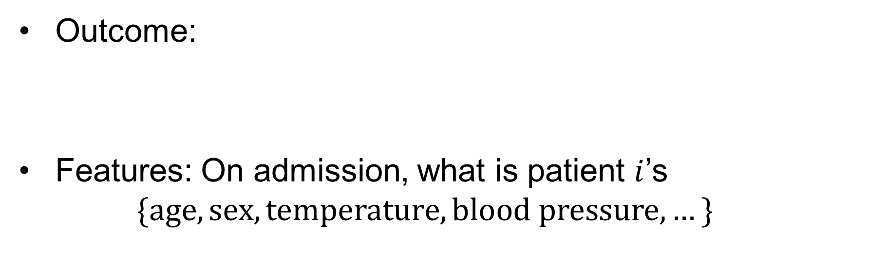
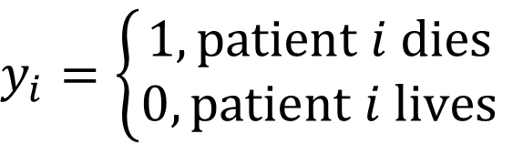
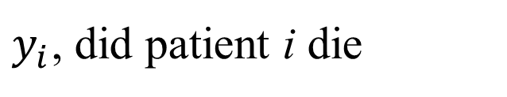
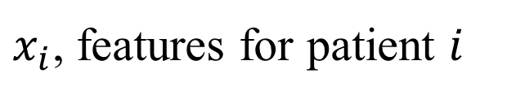
Previous Example: ICU Mortality Prediction
Outcome:
Features: On admission, what is patient $i$’s
$$\{age, sex, temperature,blood pressure,…\}$$
$$y_{i}=\left\{\begin{aligned}1, patient i dies \\ 0, patient i lives\end{aligned}\right.$$
$y_{i}$, did patient i die
$x_{i}$, features for patient $i$

Slide 14
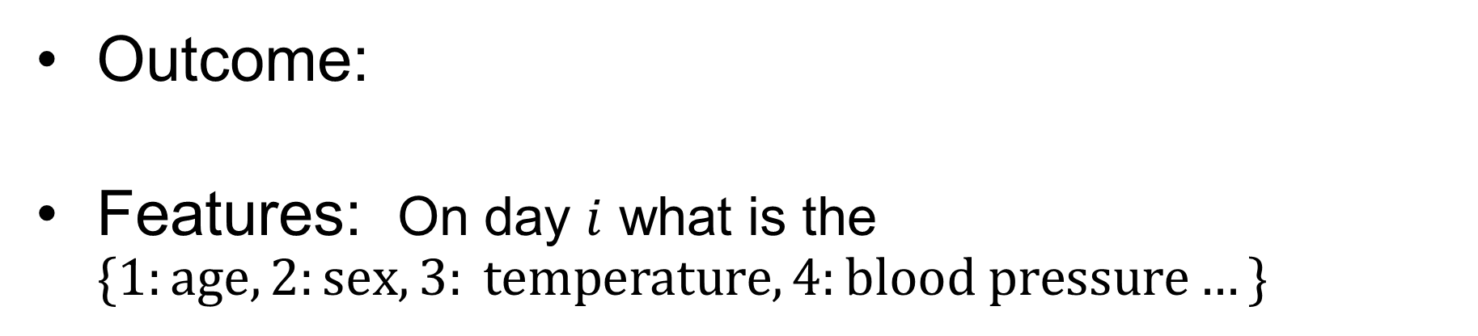
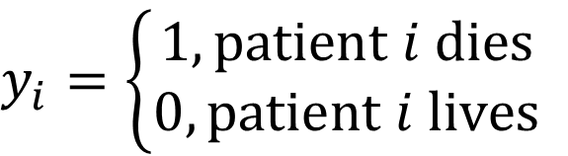
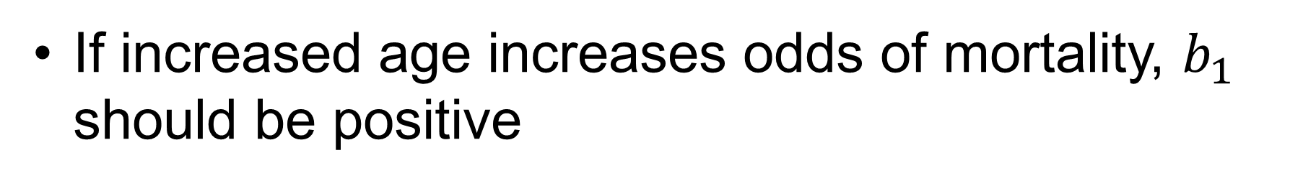
Previous Example: ICU Mortality Prediction
Outcome:
Features: On day $i$ what is the $\{1:age, 2:sex, 3: temperature, 4:blood pressure…\}$
$$y_{i}=\left\{\begin{aligned}1, patient i dies \\ 0, patient i lives\end{aligned}\right.$$
$$zi=b_{1}x_{i1}+b_{2}x_{i2}+…+b_{M}x_{iM}+b_{0}$$
Age
Blood Pressure
If increased age increases odds of mortality, $b_{1}$ should be positive

Slide 15
What’s our goal?
Answer 1: Determine who’s at highest risk of death so we can plan or manage resources accordingly
Answer 2: Identify predictors of mortality to further scientific understanding and design interventions
Notes:
Answer 1: diagnostics. Admissions prediction. Recommendation systems. Etc.
Answer 2: note that if we have this perspective, must recognize that we are not doing causal inference

Slide 16
Machine Learning: A Black Box?
p(mortality)?
Notes:
Want to highlight the issue of interpretability
How can we trust a ”black box” diagnostic if we don’t know what’s happening inside?

Slide 17
What’s our goal?
Answer 1: Determine who’s at highest risk of death so we can plan or manage resources accordingly
Answer 2: Identify predictors of mortality to further scientific understanding and design interventions
Notes:
Note that we’re not really opening up the black box here

Slide 18
What’s our goal?
DS evaluation:
Determine whether the model performs well on new data
Answer 1: Determine who’s at highest risk of death so we can plan or manage resources accordingly
Answer 2: Identify predictors of mortality to further scientific understanding and design interventions
Explanatory Approach:
Evaluate model parameters, e.g. by null-hypothesis testing
Notes:
”out of sample predictive performance”
“generalization error”

Slide 19
The Common Task Framework
The Secret Sauce of Predictive Modeling?

Slide 20
Ingredient 1: Standardized evaluation of model performance
Notes:
Not about goodness of fit tests, or comparing likelihoods between models
Not about statistical hypothesis testing
Not about any of that
It’s all about predictive performance.
And we all judge predictive performance the exact same way.

Slide 21
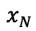
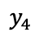
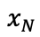
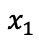
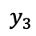
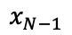
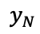
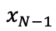
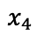
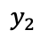
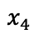
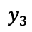
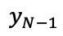
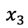
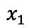
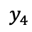
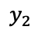
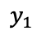
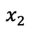
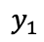
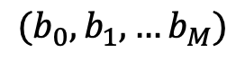
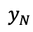
Standardized Evaluation Strategy
We want to know how the network will perform in the real world
So, we try it with new data
This is costly; instead, can we use existing data to estimate performance?
$$x_{1}$$
$$y_{1}$$
$$x_{2}$$
$$y_{2}$$
$$x_{3}$$
$$y_{3}$$
$$x_{4}$$
$$y_{4}$$
$$x_{N−1}$$
$$x_{N}$$
$$y_{N}$$
Training Set
$$x_{1}$$
$$y_{1}$$
$$x_{2}$$
$$y_{2}$$
$$x_{3}$$
$$y_{3}$$
$$x_{4}$$
$$y_{4}$$
$$x_{N−1}$$
$$y_{N−1}$$
$$x_{N}$$
$$y_{N}$$
$({b_{0},b}_{1},…b_{M})$
“New” Real-World Data
Estimate Real-World Performance
Notes:
So, for example, we might collect data on patients for two years, then hold out data on patients collected over a third year
Or we might collect data on patients in one health system, then see how model performs on patients from a different health system
Will talk more about this tomorrow – this is done to protect against overfitting

Slide 22
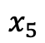
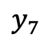
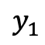
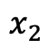
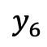
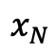
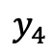
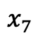
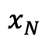
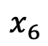
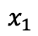
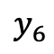
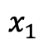
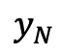
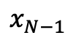
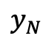
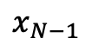
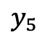
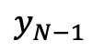
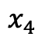
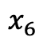















Split Data into Separate Groups
Train, Validation, Test
$$x_{1}$$
$$y_{1}$$
$$x_{1}$$
$$y_{1}$$
$$x_{2}$$
$$y_{2}$$
$$x_{2}$$
$$y_{2}$$
$$x_{3}$$
$$y_{3}$$
$$x_{3}$$
$$y_{3}$$
$$x_{4}$$
$$y_{4}$$
$$x_{4}$$
$$y_{4}$$
$$x_{5}$$
$$y_{5}$$
$$x_{5}$$
$$y_{5}$$
$$x_{6}$$
$$y_{6}$$
Random Assignment
$$x_{6}$$
$$y_{6}$$
$$x_{7}$$
$$y_{7}$$
$$x_{7}$$
$$y_{7}$$
$$x_{N−1}$$
$$y_{N−1}$$
$$x_{N−1}$$
$$y_{N−1}$$
$$x_{N}$$
$$y_{N}$$
$$x_{N}$$
$$y_{N}$$
All Available Data

Slide 23




















































Split Data into Separate Groups
Train
$$x_{1}$$
$$y_{1}$$
$$x_{2}$$
$$y_{2}$$
$$x_{1}$$
$$y_{1}$$
$$x_{3}$$
$$y_{3}$$
$$x_{4}$$
$$y_{4}$$
$$x_{2}$$
$$y_{2}$$
$$x_{3}$$
$$y_{3}$$
$$x_{N−1}$$
$$y_{N−1}$$
$$x_{4}$$
$$y_{4}$$
$$x_{N}$$
$$y_{N}$$
$$y_{5}$$
$$x_{1}$$
$$y_{1}$$
$$x_{5}$$
$$x_{2}$$
$$y_{2}$$
$$x_{6}$$
$$y_{6}$$
$$x_{3}$$
$$y_{3}$$
$$x_{4}$$
$$y_{4}$$
$$x_{7}$$
$$y_{7}$$
$$x_{1}$$
$$y_{1}$$
$$x_{N−1}$$
$$y_{N−1}$$
$$x_{2}$$
$$y_{2}$$
$$x_{N}$$
$$y_{N}$$
$$x_{3}$$
$$y_{3}$$
Test
$$y_{N−1}$$
$$x_{4}$$
$$y_{4}$$
$$x_{N−1}$$
$$x_{N}$$
$$y_{N}$$
$$x_{N−1}$$
$$y_{N−1}$$
All Available Data
$$x_{N}$$
$$y_{N}$$
Validation

Slide 24
Test set
This should be set aside prior to any analysis, and will not be used to learn or fit any parameters
After learning the model, we evaluate its performance on the test set
This data was not included in the training/fitting, so it is analogous to running a new synthetic experiment
Ideally, the test set will be used once.
Reusing the test set leads to bias; performance estimates will be optimistic
So, how do we compare different models?

Slide 25
Validation (or Tuning) Set
Want to be able to compare which approach is best
Problematic if we only want to use a test set once
Can create a second held-out dataset
The validation data is not used for learning parameters, but can be used repeatedly to estimate performance of a model
We can pick the model with the best performance on the validation set, and run a final evaluation on the test data

Slide 26



































Refine Model
$$x_{1}$$
$$y_{1}$$
$$x_{1}$$
$$y_{1}$$
$$x_{2}$$
$$y_{2}$$
$$x_{2}$$
$$y_{2}$$
$$x_{3}$$
$$y_{3}$$
$$x_{3}$$
$$y_{3}$$
$$x_{4}$$
$$y_{4}$$
$$x_{4}$$
$$y_{4}$$
$$x_{1}$$
$$y_{1}$$
$$x_{N−1}$$
$$x_{2}$$
$$y_{2}$$
$$x_{N−1}$$
$$y_{N−1}$$
$$x_{N}$$
$$y_{N}$$
$$x_{3}$$
$$y_{3}$$
$$x_{N}$$
$$y_{N}$$
Training Set
$$x_{4}$$
$$y_{4}$$
Test
$$x_{N−1}$$
$$y_{N−1}$$
$$x_{N}$$
$$y_{N}$$
$({b_{0},b}_{1},…b_{M})$
Validation
Estimate Performance on Validation Set
Final Performance Evaluation

Slide 27
Pitfalls: Training, Validation, and Test
This can be more nuanced than it might seem, and is a common source of methodological errors!
Pitfall 1: Multiple data points from the same individual or source
Pitfall 2: Utilizing data from the test or validation set prior to “modeling”
feature selection using the whole dataset
other information “leaks”
Pitfall 3: Systematic differences between test, validation, and training sets
Notes:
Essentially, multiple records from a single person is “clustered data”. If you split them across sets, you are still overfitting.
Need to assign these to the same split.
And PITFALL 0: Evaluating multiple times on the test set
Think of it like a randomization scheme, where it depends on the study design.

Slide 28
Pitfalls: Training, Validation, and Test
This can be more nuanced than it might seem, and is a common source of methodological errors!
PITFALL 0: Repeatedly evaluating on the test set!
Pitfall 1: Multiple data points from the same individual or source
Pitfall 2: Utilizing data from the test or validation set prior to “modeling”
feature selection using the whole dataset
other information “leaks”
Pitfall 3: Systematic differences between test, validation, and training sets
Notes:
Essentially, multiple records from a single person is “clustered data”. If you split them across sets, you are still overfitting.
Need to assign these to the same split.
And PITFALL 0: Evaluating multiple times on the test set
Think of it like a randomization scheme, where it depends on the study design.

Slide 29
Ingredient 1: Standardized evaluation of model performance
Ingredient 2: Publicly-available training datasets
Notes:
Annotated
Fixed train/val/test splits
Test data sometimes withheld, e.g. for competitions

Slide 30
Notes:
Point out that there are MANY more, particularly for vision

Slide 31



Slide 32

Stanford Question Answering Dataset (SQuAD 2.0)
Notes:
SQuAD 2.0 developed in 2016
Paragraphs of content along with questions about that content
Here we have paragraph about the immune system along with relevant questions that can be answered. But again, not all of these questions can be answered, and it is important for the system to recognize this.
Exact match. This metric measures the percentage of predictions that match any one of the ground truth answers exactly.
(Macro-averaged) F1 score. This metric measures the average overlap between the prediction and ground truth answer. We treat the prediction and ground truth as bags of tokens, and compute their F1. We take the maximum F1 over all of the ground truth answers for a given question, and then average over all of the questions

Slide 33
Amazon Reviews Dataset
{"reviewerID": "A2SUAM1J3GNN3B",
"asin": "0000013714",
"reviewerName": "J. McDonald",
"helpful": [2, 3],
"reviewText":
"I bought this for my husband who plays the piano. He is having a wonderful time playing these old hymns. The music is at times hard to read because we think the book was published for singing from more than playing from. Great purchase though!",
"overall": 5.0,
"summary": "Heavenly Highway Hymns",
"unixReviewTime": 1252800000,
"reviewTime": "09 13, 2009”}
Notes:
The point is that we have all these HUGE datasets, and absolutely anybody can access and start working with them. The big challenges of AI are being knocked down largely because these data are out there – creates its own demand.
In medicine, we’re working toward it.

Slide 34


Slide 35
Notes:
The big one we DON’T have – is EHR data. Very little standardization here. It’s a problem!

Slide 36
Ingredient 1: Standardized evaluation of model performance
Ingredient 2: Publicly-available training datasets
Ingredient 3: Competition with Impartial Scoring
Notes:
Annotated
Fixed train/val/test splits
Test data sometimes withheld, e.g. for competitions

Slide 37

Notes:
Some competition occurs naturally from making these data available
Other competition is deliberately encouraged through challenges and prizes

Slide 38


Slide 39


Slide 40

Deep Learning is Approaching Human Performance in Language Understanding Tasks
Notes:
SQuAD 2.0 developed in 2016
Paragraphs of content along with questions about that content
Here we have paragraph about the immune system along with relevant questions that can be answered. But again, not all of these questions can be answered, and it is important for the system to recognize this.
Exact match. This metric measures the percentage of predictions that match any one of the ground truth answers exactly.
(Macro-averaged) F1 score. This metric measures the average overlap between the prediction and ground truth answer. We treat the prediction and ground truth as bags of tokens, and compute their F1. We take the maximum F1 over all of the ground truth answers for a given question, and then average over all of the questions

Slide 41


Slide 42


NO CHEATING!
You submit your model, and the organizers apply it to the test set, which is not publicly-available

Slide 43
Ingredient 1: Standardized evaluation of model performance
Ingredient 2: Publicly-available training datasets
Ingredient 3: Competition with Impartial Scoring
Ingredient 4: Openness and code sharing
Notes:
Annotated
Fixed train/val/test splits
Test data sometimes withheld, e.g. for competitions

Slide 44



Slide 45
Less Stats Theory, More CS Theory and Culture
In 2001, William S. Cleveland (of Bell Labs) wrote that:
...[results in] data science should be judged by the extent to which they enable the analyst to learn from data... Tools that are used by the data analyst are of direct benefit. Theories that serve as a basis for developing tools are of indirect benefit.
He proposed 6 foci of activity, even suggesting allocations of effort.
Multidisciplinary investigations (25%)
Models and Methods for Data (20%)
Computing with Data (15%)
Pedagogy (15%)
Tool Evaluation (5%)
Theory (20%)
Several academic statistics departments that I know well could, at the time of Cleveland’s publication, fit 100% of their activity into the 20% Cleveland allowed for Theory. Cleveland’s paper was republished in 2014. I can’t think of an academic department that devotes today 15% of its effort on pedagogy, or 15% on Computing with Data. I can think of several academic statistics departments that continue to fit essentially all their activity into the last category, Theory.
-- David Donoho, 50 years of Data Science
Notes:
Theory of algorithms rather than stats theory
Note that to some extent, you have to experience how the cultures are different
Engineering culture rather than stats culture?

